Slide 1
An Introduction to MPEG
June, 1999

Slide 2
Motion JPEG
JPEG system for compressing static images could be applied to a sequence of images, compressing each individually, this is called motion JPEG
Motion JPEG takes no advantage of any correlation between successive images
In a typical scene there will be a great deal of similarity between nearby images of the same sequence.

Slide 3
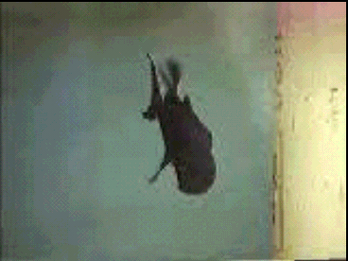
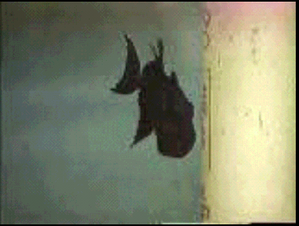
In a typical scene there will be a great deal of similarity between nearby images of the same sequence.

Slide 4
Motion Compensation Approach
Basic idea of Motion Compensation:
  Many “moving” images or image sequences consist of a static background with one or more moving foreground objects. We can get coding advantage from this.
  we code the first frame by baseline JPEG and use this frame as reference image.
  Treat the second image block by block and compare each block with the same block in the reference image.
  For blocks that have identical block in reference image, we only send a special code instead of whole code.
  For other blocks, we just encode them as usual.

Slide 5
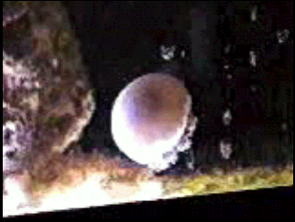
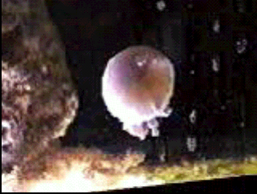
Motion Compensation Approach(cont.)
Motion Vectors
  static background is a very special case, we should consider the displacement of the block.
  Motion vector is used to inform decoder exactly where in the previous image to get the data.
  Motion vector would be zero for a static background.

Slide 6
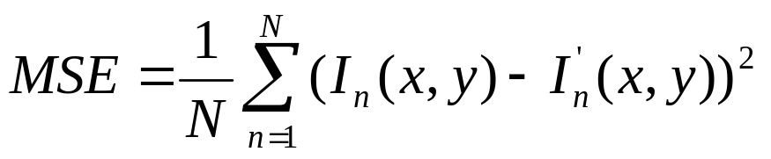
Motion Compensation Approach(cont.)
Block Matching--how to find the matching block?
  Matching criteria:
    In practice we couldn’t expect to find the exactly identical matching block, instead we look for close match.
    Most motion estimation schemes look for minimum mean square error(MMSE) between block.
  Matching block size:
    How large the matching block will affect coding efficiency
    block size MPEG used: 16×16

Slide 7
Motion Compensation Approach(cont.)
Search range:
  It’s reasonable to consider an displacement of 360 pixles/s or about 60pixels/image in standard-definition television.
  In real-world scenes there is usually more or faster motion horizontally than vertically, generally the width of search area should be twice the height.
  Suggested search range: ±60 pixles × 30 pixles

Slide 8
Motion Compensation Approach(cont.)
Residuals
  The differences between the block being coded and it’s best match are known as residuals.
  The residuals maybe encoded and transmitted along with the motion vector, so the decoder will be able to reconstruct the block.
  We should compare the bits of transmitting the motion vector plus the residuals with the bits of transmitting the block itself and use the most efficient mechanism.

Slide 9
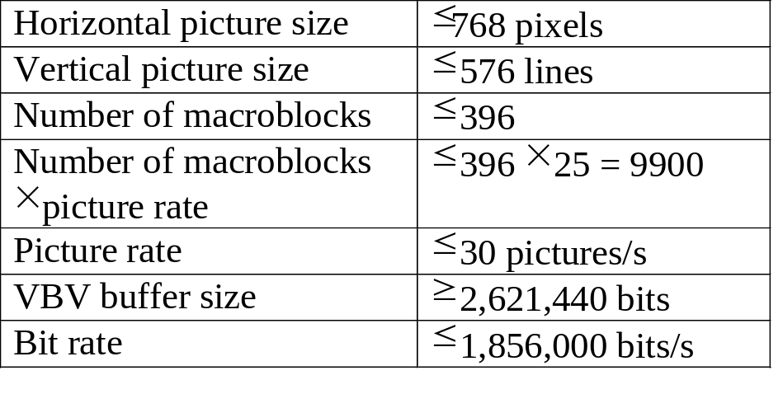
MPEG-1 Introduction
  MPEG: Moving Pictures Experts Group.
  MPEG-video is addressing the compression of video signals at about 1.5Mbits/s
  MPEG-1 is asymmetric system, the complexity of the encoder is much higher than that of the decoder.
Table 1: MPEG-1 Constraints

Slide 10
MPEG Hierarchy
The six layers of MPEG video bit stream
Sequence Layer: video clip, complete program item.
Group of Pictures Layer(GOP): include three different coding ways.
Frame Layer
Slice Layer: in case the data is lost or corrupted.
Macroblock Layer: 16×16 luminance block.
Block Layer(DCT unit)

Slide 11
Frame Types in MPEG
Intra frames (I-frames)
  A I-frame is encoded using only information from within that frame(intra coded) -- no temporal compression(inter coded).
Non-intra frames (P-frames and B-frames)
  motion compensated information will be used for coding.
  P frame (predicted frame) use preceding frame as reference image
  B frame (bidirectional frame) use both preceding frame and following frame as reference images

Slide 12



Motion estimation for different frames
X
Z
Available from earlier frame (X)
Available from later frame (Z)
Y

Slide 13
Reconstructing a reference frame that will be the same as at the decoder
Frame
being
coded
Variable
length
code
To
transmit
buffer
DCT
Quantize
Reference
frame
Inverse
DCT
De-
quantize

Slide 14
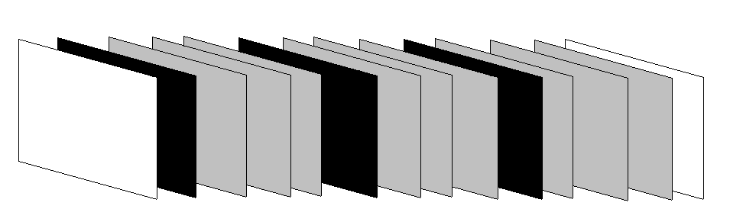
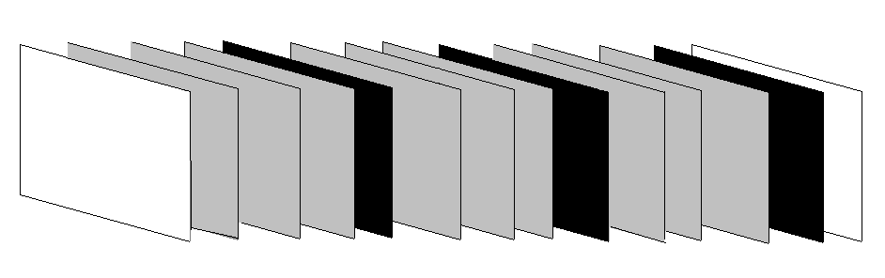
A typical group of pictures in display order
I P B B B P B B B P B B B
1 5 2 3 4 9 6 7 8 13 10 11 12
A typical group of pictures in coding order
I B B B P B B B P B B B P

Slide 15
Coding of Macroblock
Y
C_{B}
C_{R}
0
1
4
5
2
3
♣ ♣
♦
♣ ♣
Spatial sampling relationship for MPEG-1
♣ -- Luminance sample
♦ -- Color difference sample

Slide 16
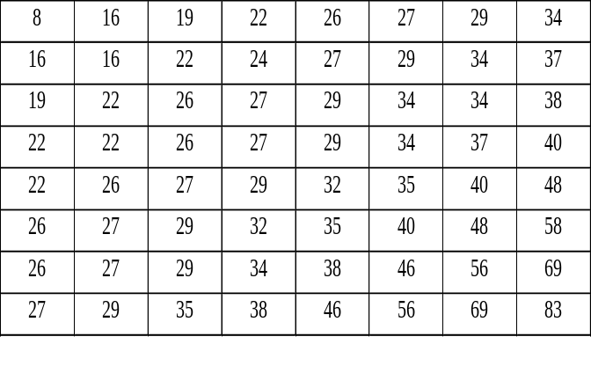
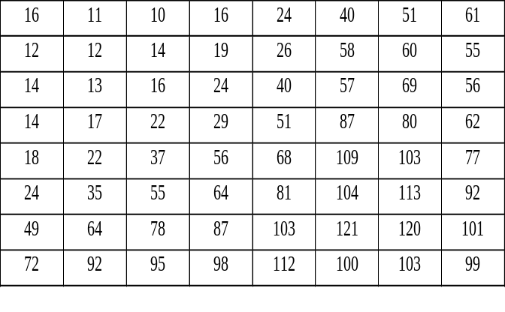
Coding of Macroblock (cont.)
Intra coding of macroblocks
  just as what JPEG does
  MPEG has two default quantization tables, one for intra coding, another one for non-intra coding of residuals
MPEG quantization table(for intra coding)
JPEG quantization table(luminance)

Slide 17
Coding of Macroblock (cont.)
Non-intra coding of macroblocks
The first step is to intra code the macroblock--just in case if we fail to find a reasonable match in motion estimation.
Then we use motion estimation to find the nearest match and get the motion vector. Only luminance samples are used in motion estimation.
Then each DCT block in macroblock will be treated separately. The residuals will be encode by DCT and quantization (use flat table) as in intra coding. DC along with AC
This process is applied to all six blocks in the macroblock
Motion vectors are coded predictively

Slide 18
Coding of Macroblock (cont.)
P-frames
  If the block can be skipped, we just send a “skip” code
  otherwise, we compare the number of total bits of inter and intra coding, choose the more efficient one. Mark this block accordingly.
B-frames
  comparison among three methods of encoding

Slide 19
A Simplified MPEG encoder
Scale
factor
Rate
controller
Buffer
fullness
IN
Frame
recorder
Variable-length
coder
Transmit
buffer
OUT
DCT
Quantize
DC
Motion
predictor
Prediction
De-
quantize
Prediction
encoder
Reference
frame
Inverse
DCT
Motion vectors

